Slide 1


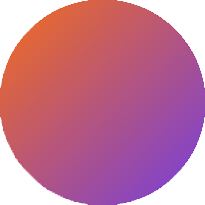

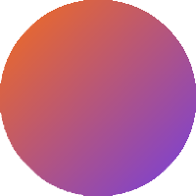
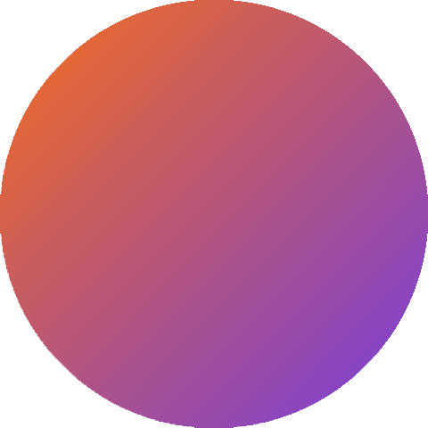
NEXT WORD
PREDICTOR
C A P S T O N E P R O J E C T

Slide 2


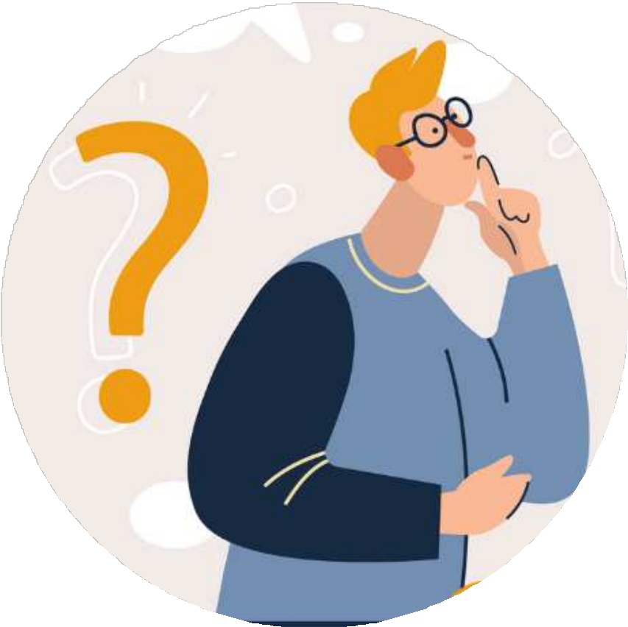

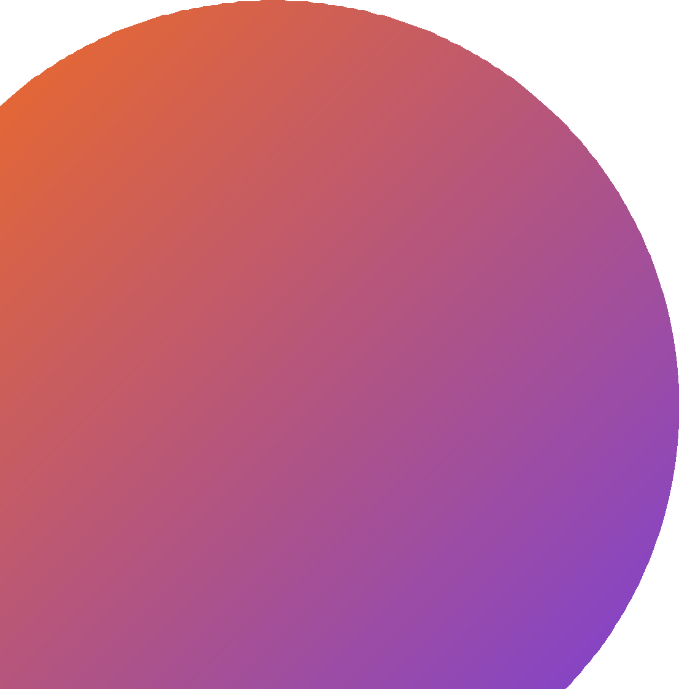
PROBLEM STATEMENT
There are many visually impaired individuals, who are unable to use their hands effectively to use any kind of device. They may find this as a disappointment as they might be unable to get a proper response from someone or communicate effectively .
Thus, we need a next word prediction system that can assist disabled people in typing and suggest the next words they intend to type based on their previous input. It can be an effective solution for them to emerge in the world.

Slide 3
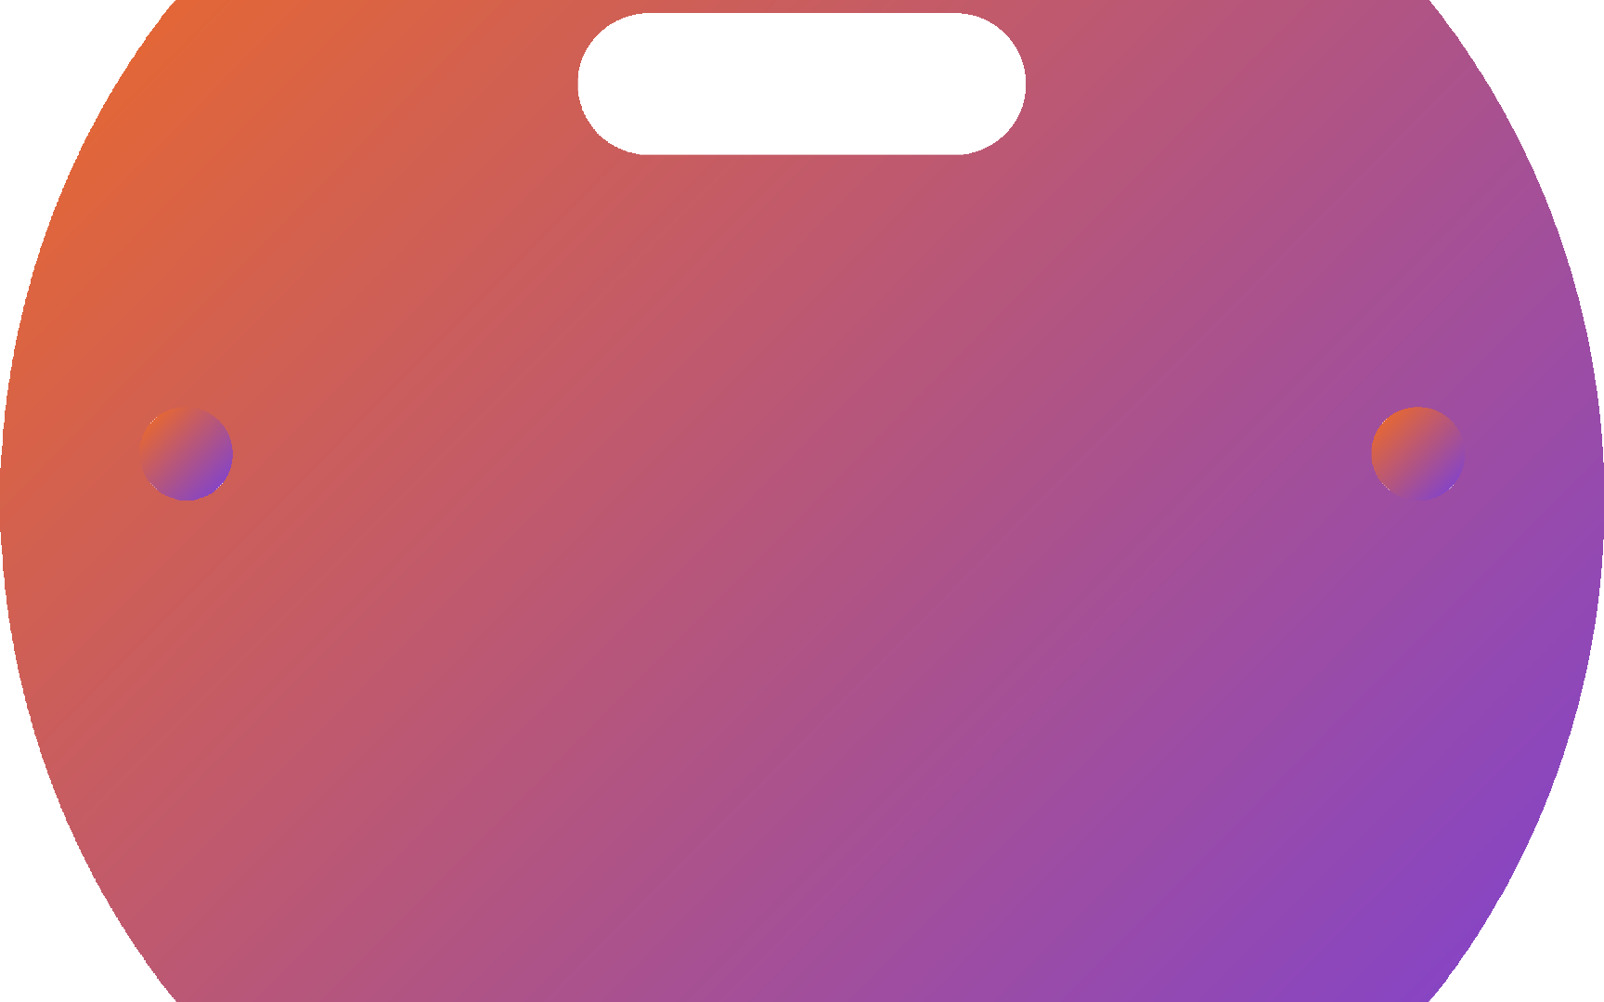

Solution
To resolve this problem, we've come up with the idea of implementation on TTS(Text-to-speech) and STT (Speech-to- text) by using Speech Recognition technology.
The web application is designed with the ability to accurately predict the intended word and provide feedback to the user in a clear and accessible manner. It is also customizable as the user's individual typing style and offer a range of options for input methods.
"The goal of our system is to increase the speed and accuracy of typing for blind and common individuals and improve their overall accessibility to technology."
In advance, text recognition feature has been implemented, after uploading an image, it will append the text-box area.
For admin, we've focused on word cloud visualization for feedback. So, We can collect feedback from customers and do analysis of it, and after post analysis, we conclude by saying, we received x% positive feedback, y% as negative feedback.

Slide 4









FEATURES OF THE PRODUCT
01
Database Implementation
Implementation of Speech Recognition Technology
Text Recognition, after uploading an image using google-cloud-vision
Login page for users and admin
A feedback form, to improve experience of users and to enhance the project
Feedback visualization for admin users
02
03
04
05
06

Slide 5
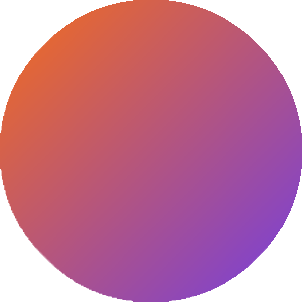
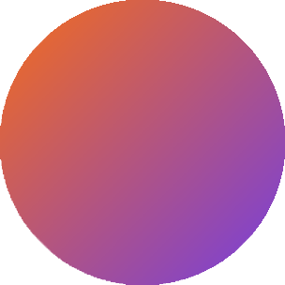
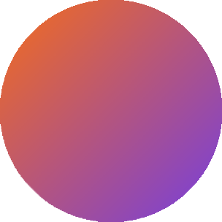
BENEFITS OF USING NEXT WORD
PREDICTOR AND SPEECH RECOGNITION
Improved accuracy
NWP can help STT software more accurately transcribe spoken language by predicting the next word based on the context of the previous words. This can reduce errors and improve the overall accuracy of the transcribed text.
Increased speed
NWP can also help blind people type more quickly and accurately by predicting the next word they intend to type. This can significantly increase their typing speed and efficiency.
01
02
Improved productivity and Independance
By using TTS with NWP, blind people can listen to text and compose messages more quickly and accurately. If the user intends to upload an image of the text he intends to type, he can upload it and application will recognize the text in it
03
Enhanced communication
By using STT with NWP, blind people can communicate more effectively and efficiently, as they can dictate their messages more quickly and accurately. This can improve their ability to participate in conversations, send emails, and compose other written communication.
04

Slide 6
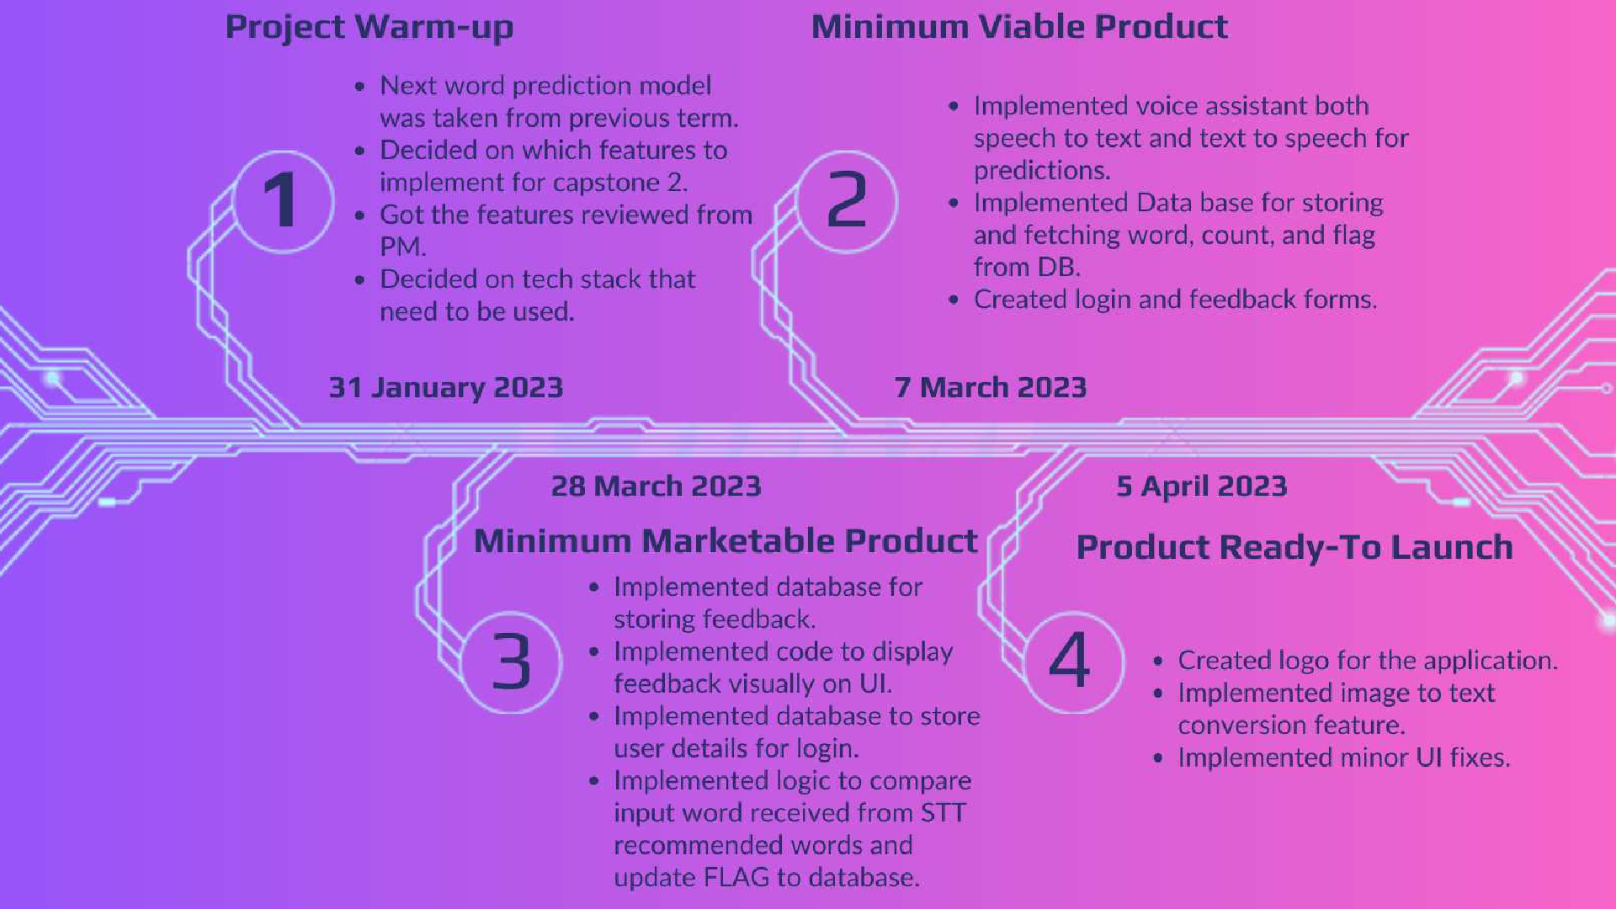

Slide 7
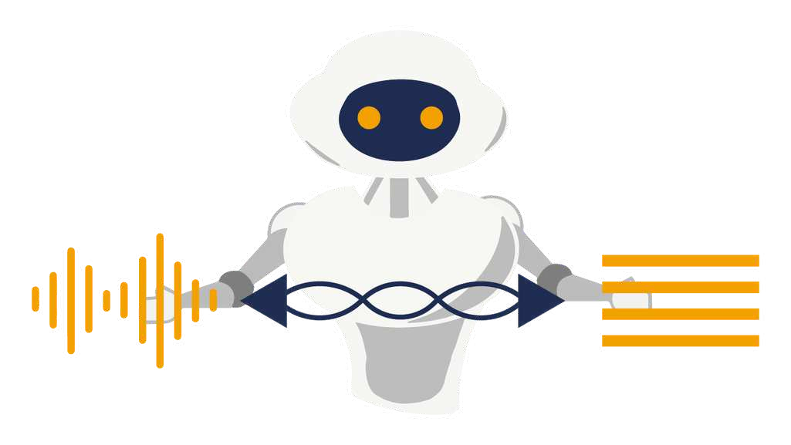

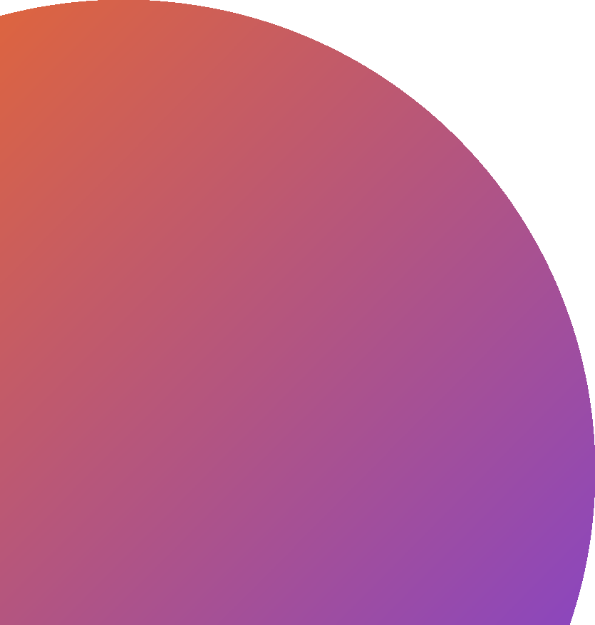
FUTURE SCOPE
Creating mobile application of our Next Word predictor.
Creating user friendly UI. 3.Multi language support.
Giving more than 3 predictions may be
upto 5 words.
Looking for prediction in database where we store new words used by user . Currently our application is only giving predictions looking at dataset we can make our app look for predictions in database+dataset in future.
Implement voice assistant for login and feedback.

Slide 8

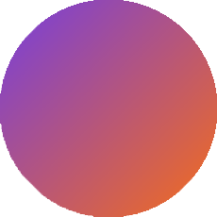
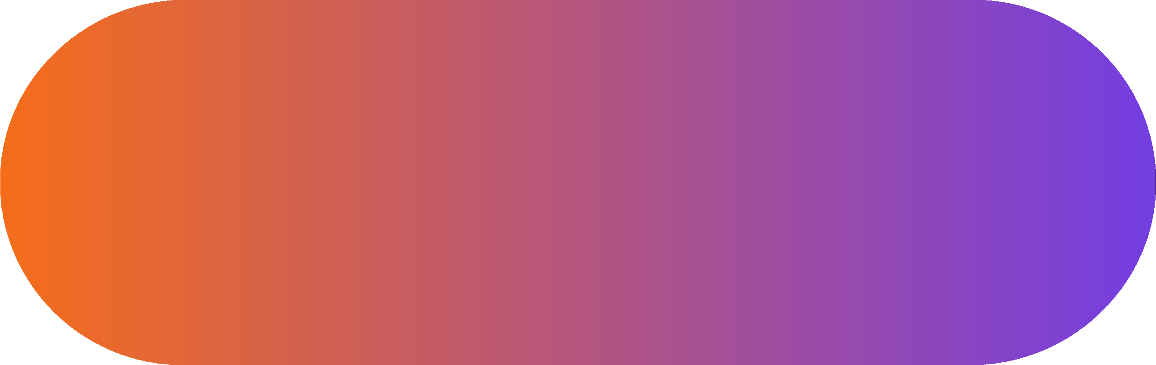


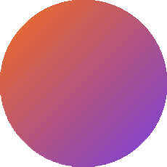
UI presentation of our web-application

Slide 9
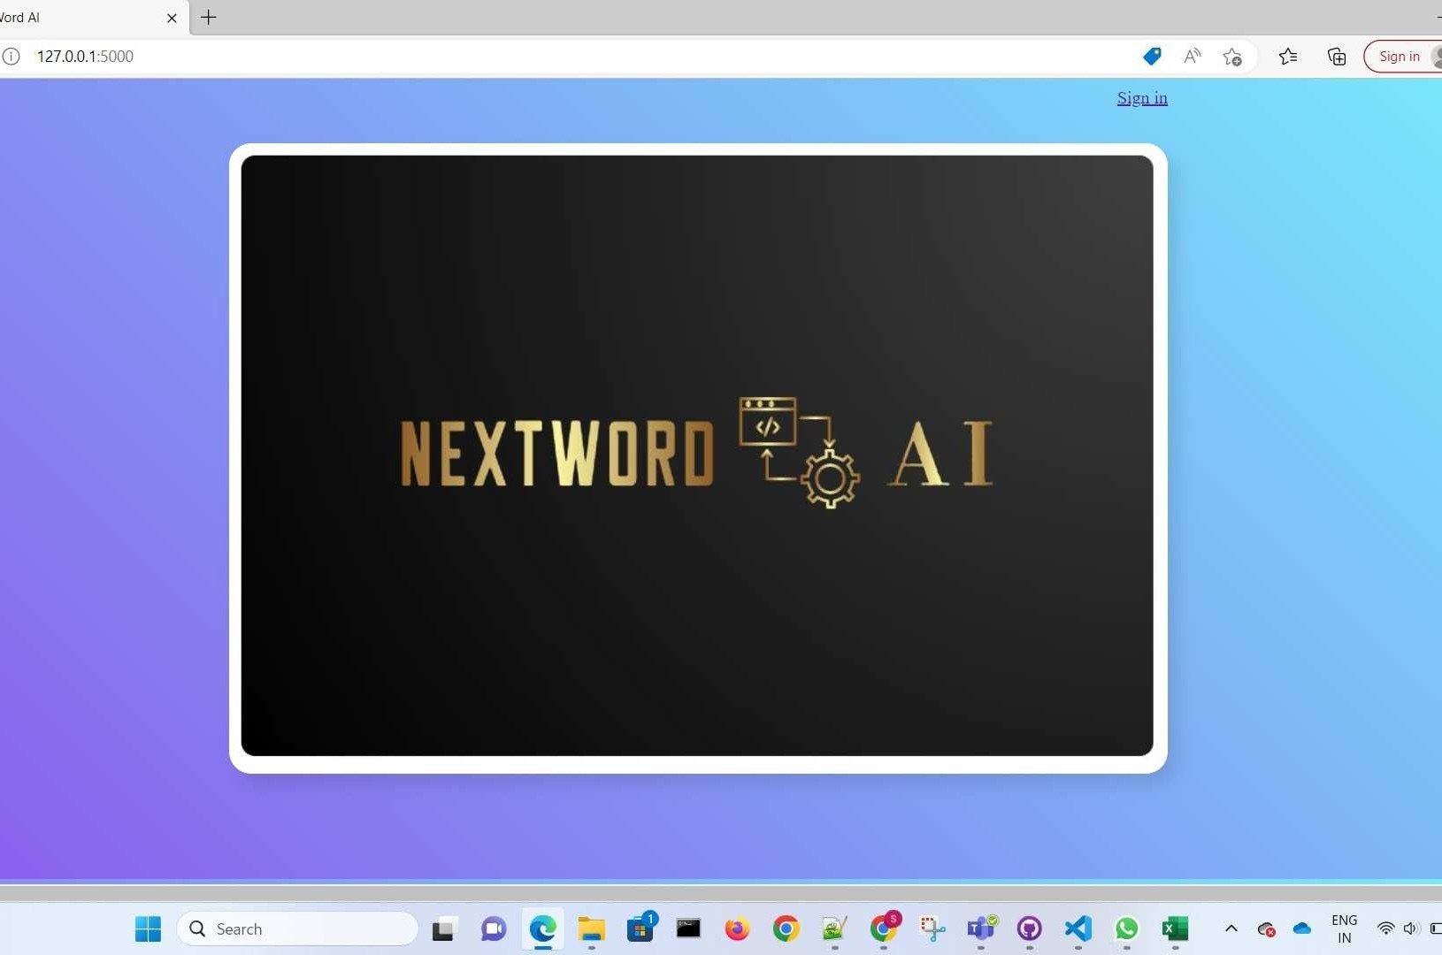

Slide 10
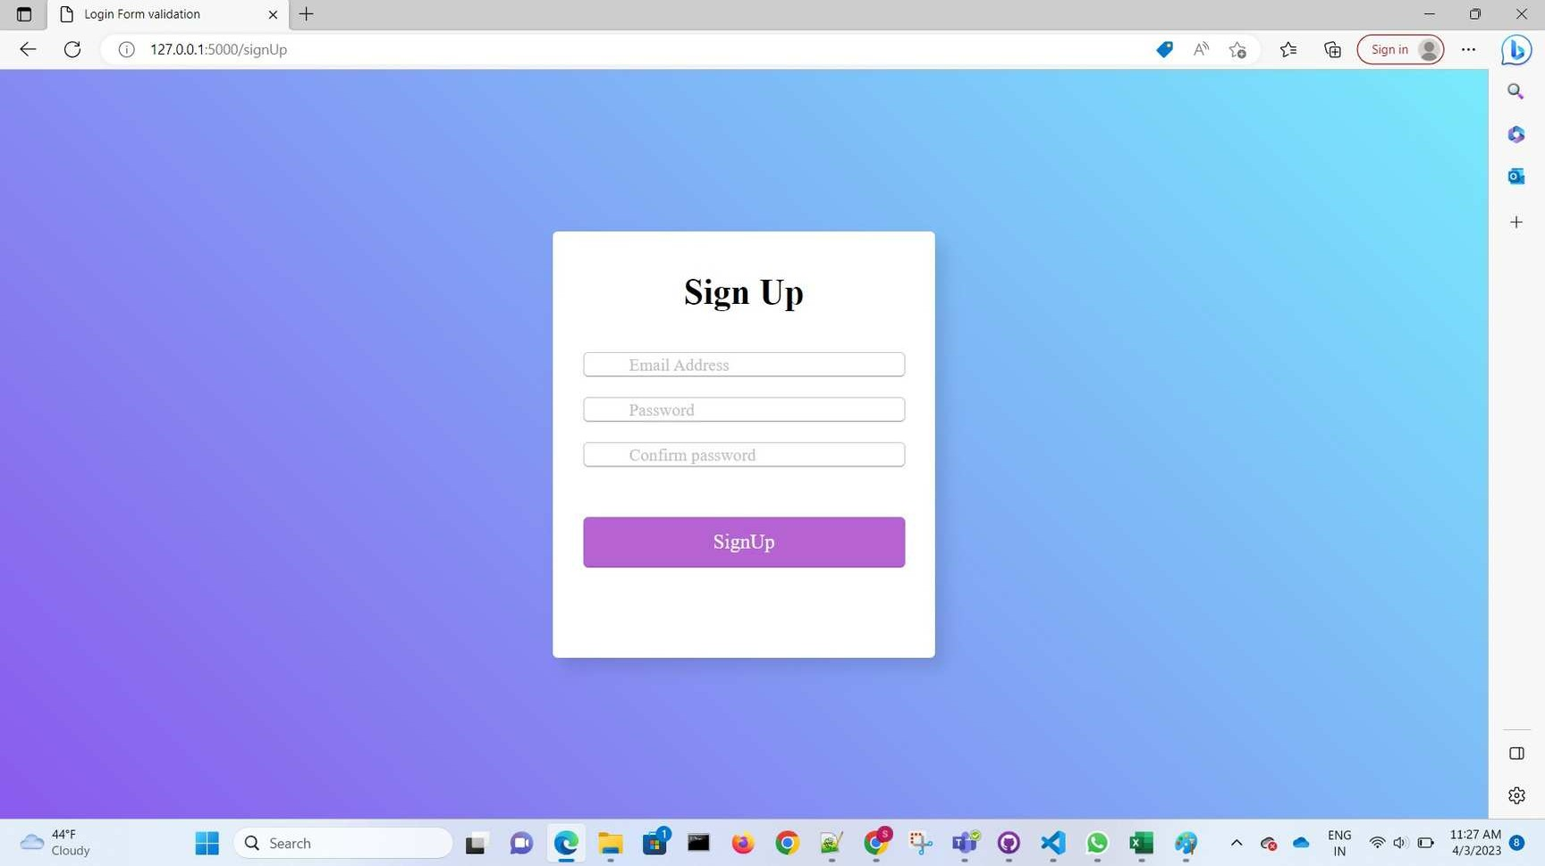

Slide 11
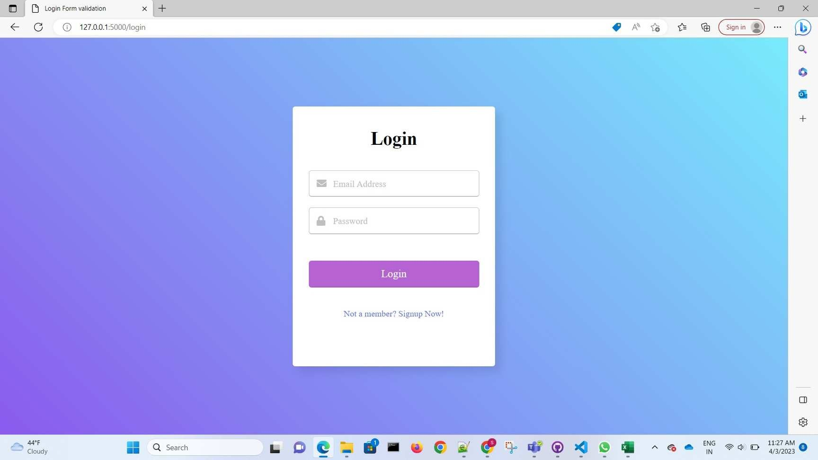

Slide 12
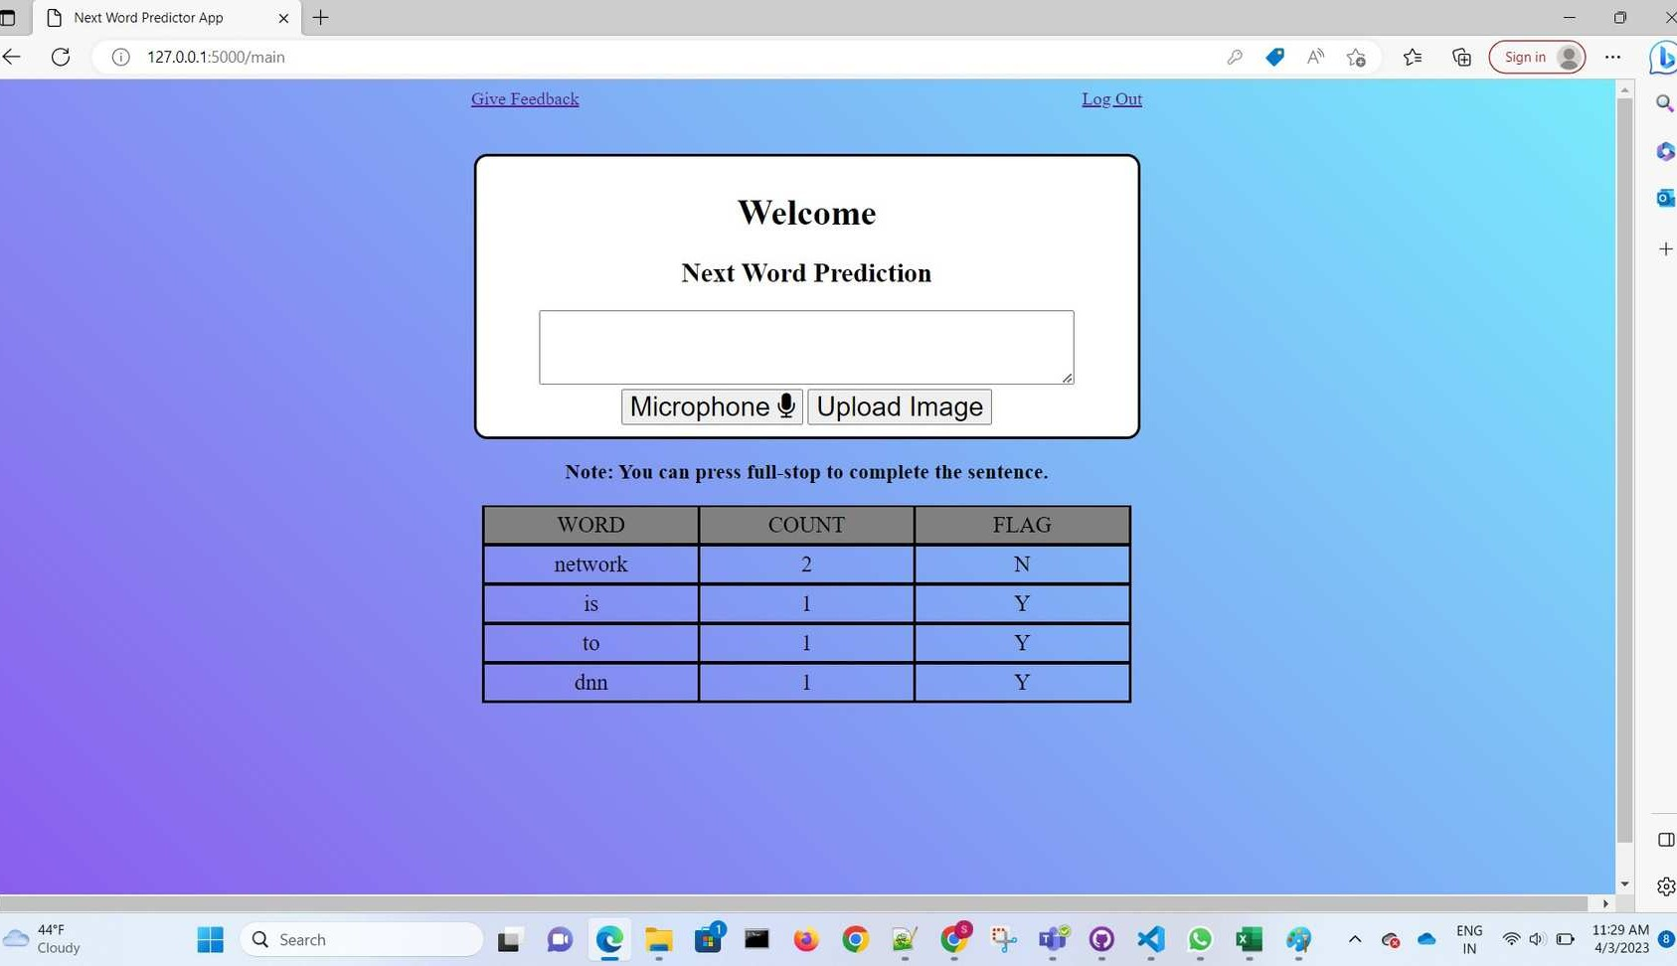

Slide 13
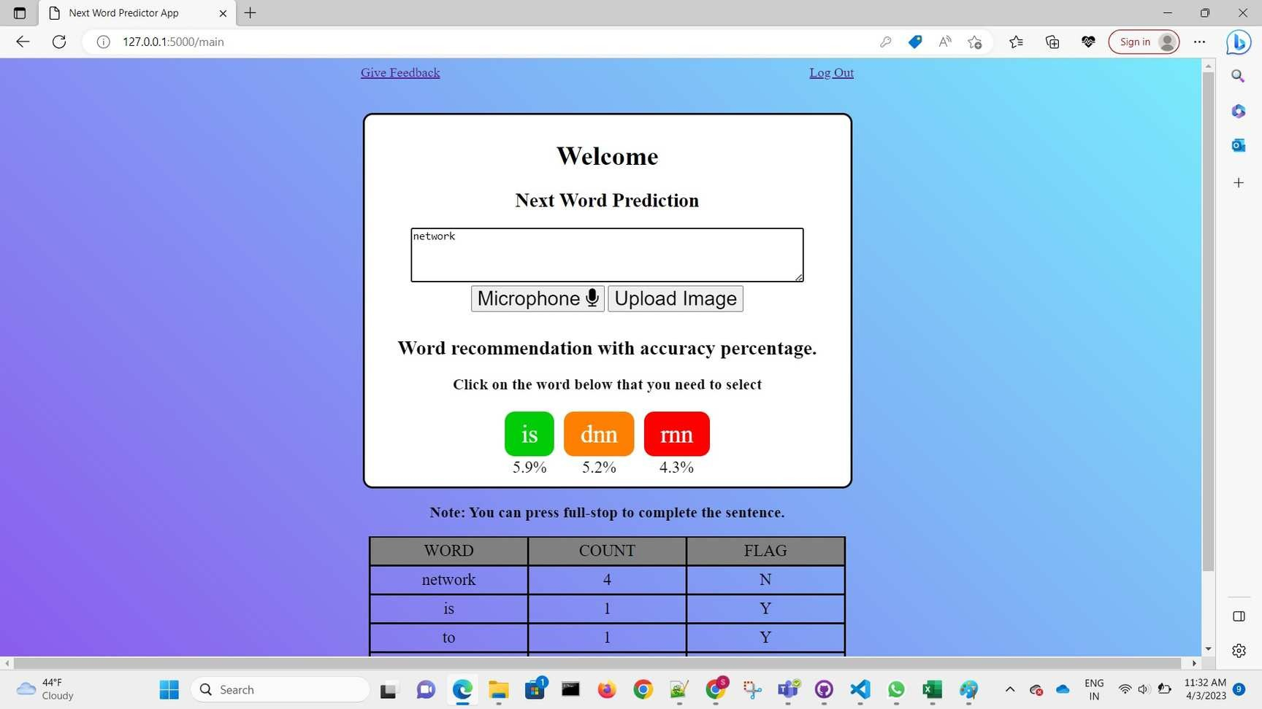

Slide 14
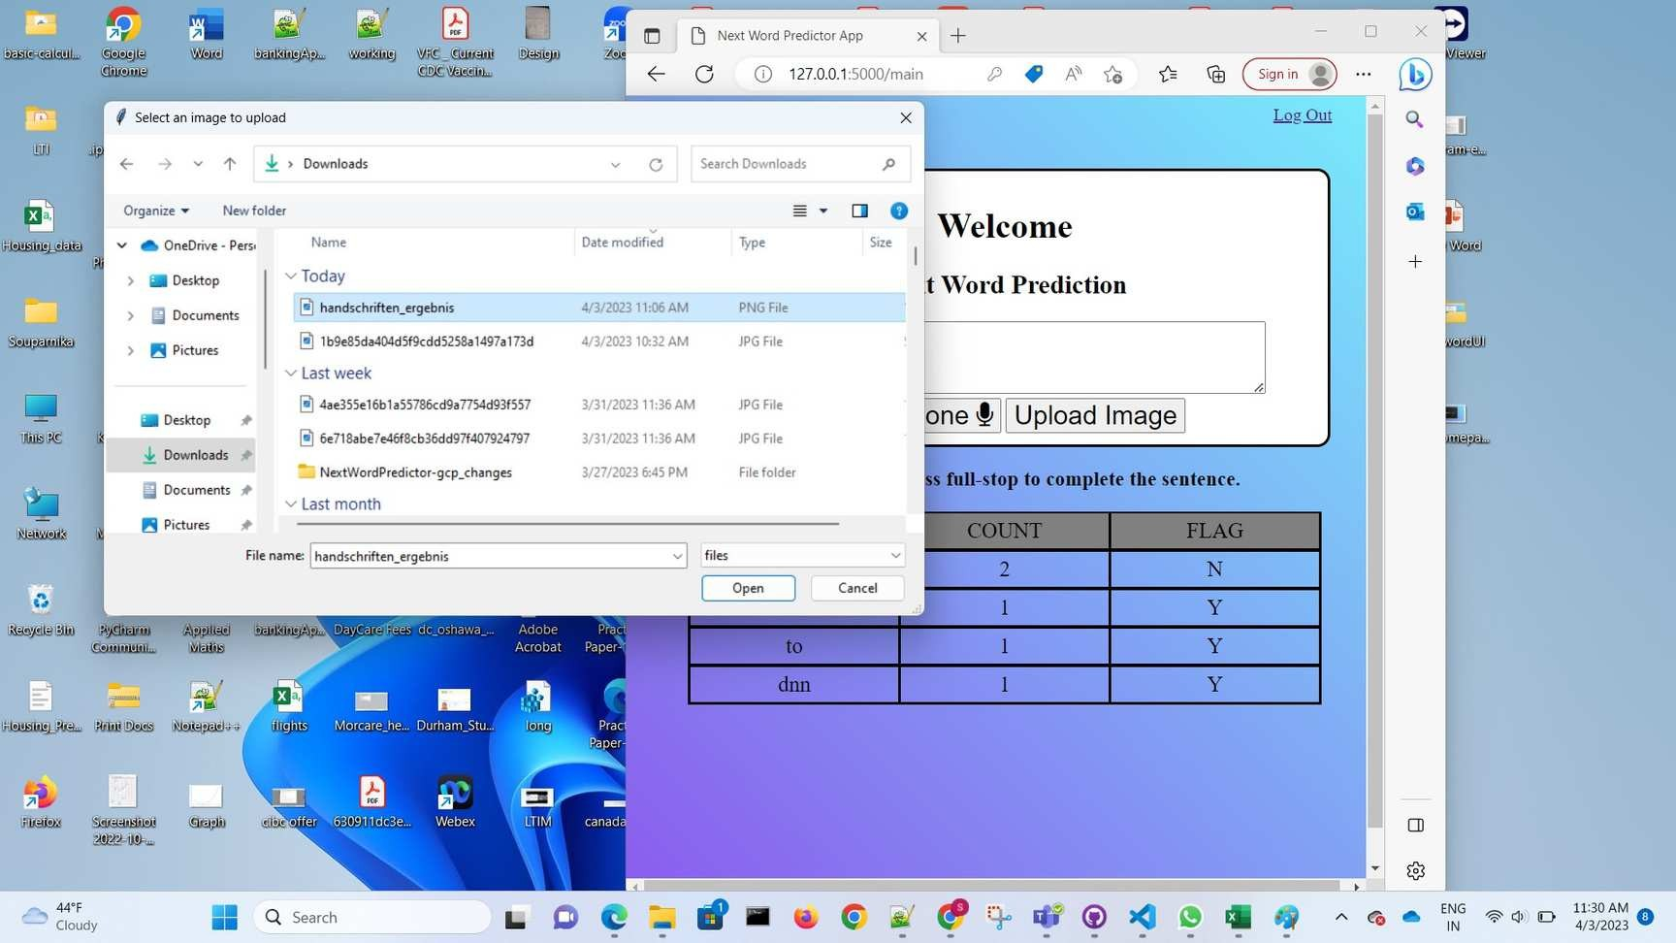

Slide 15
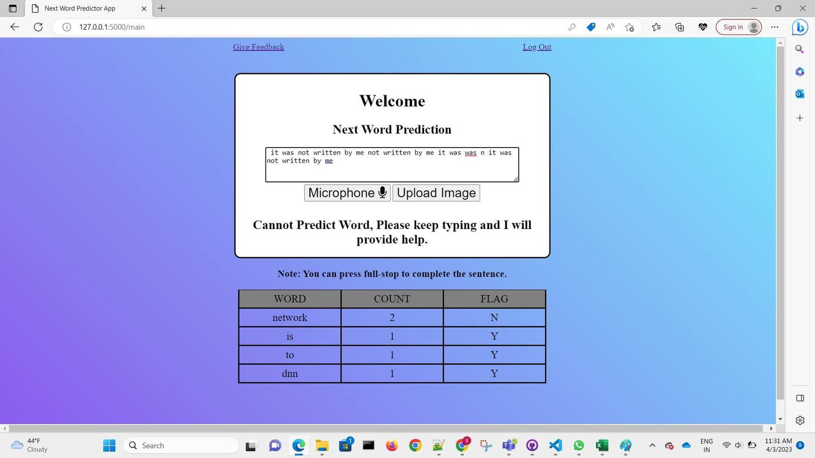

Slide 16
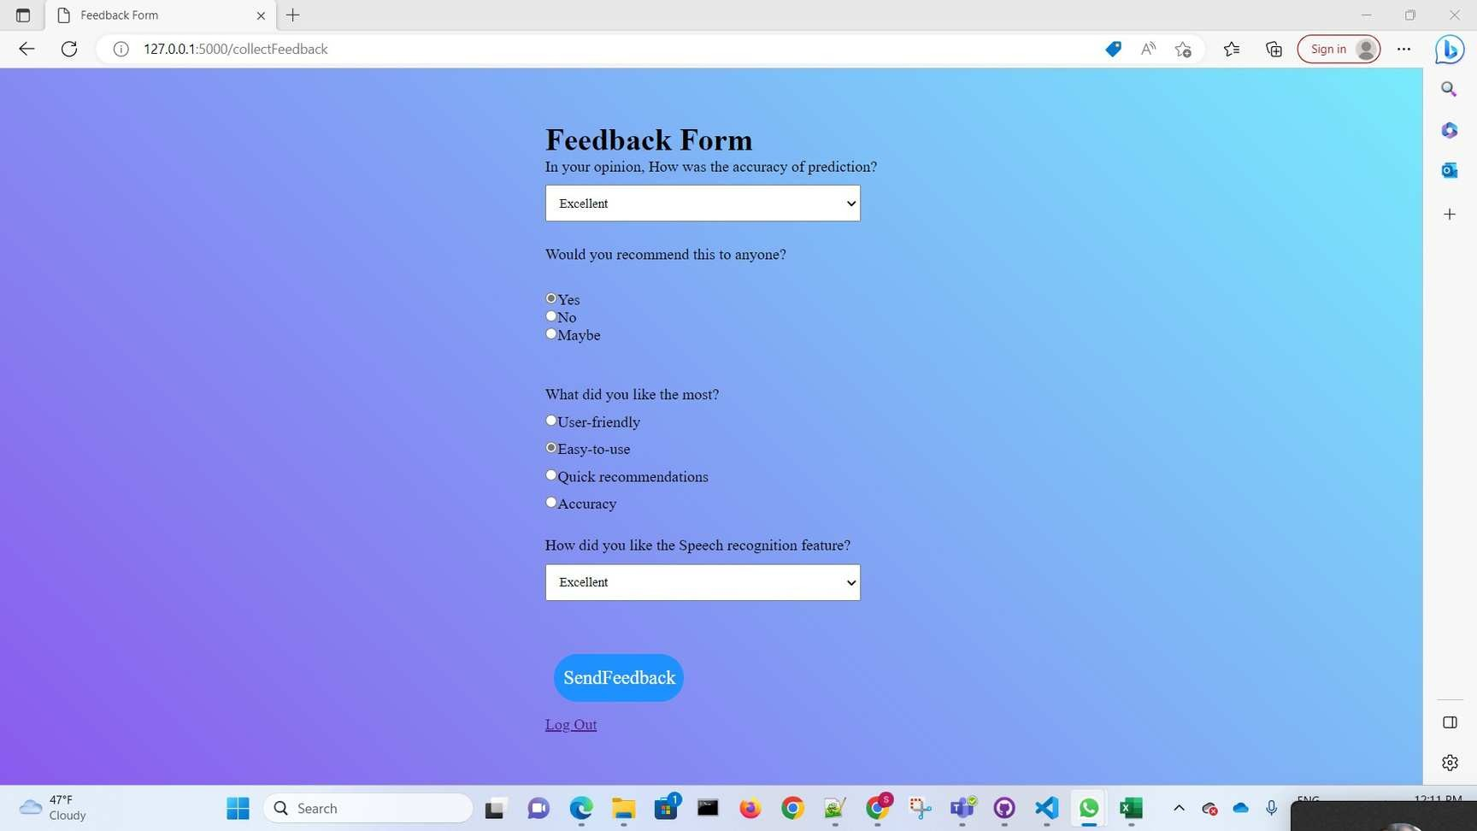

Slide 17
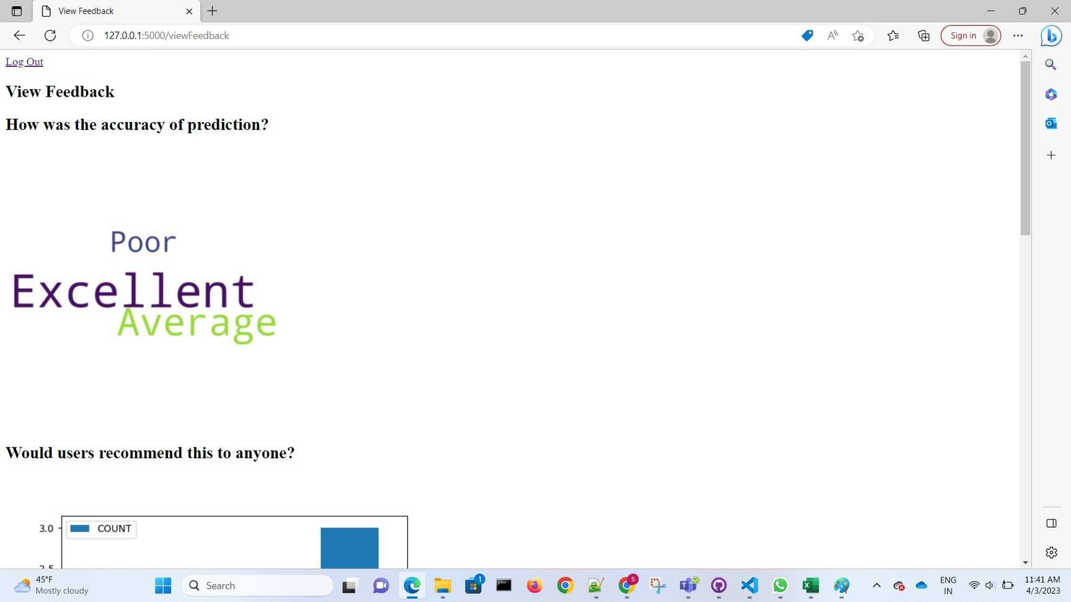

Slide 18
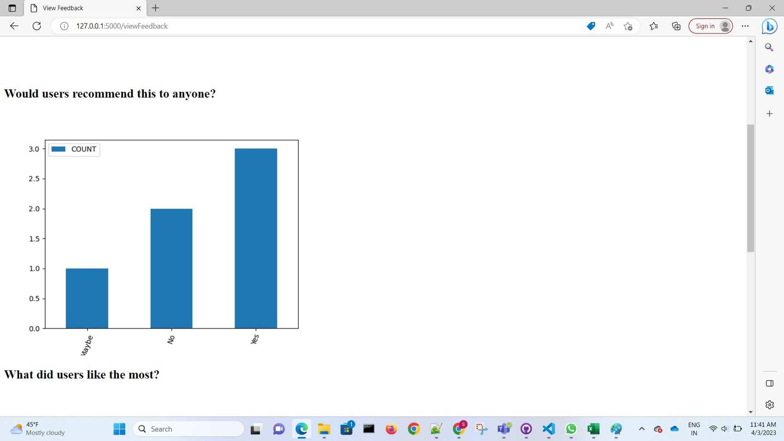

Slide 19
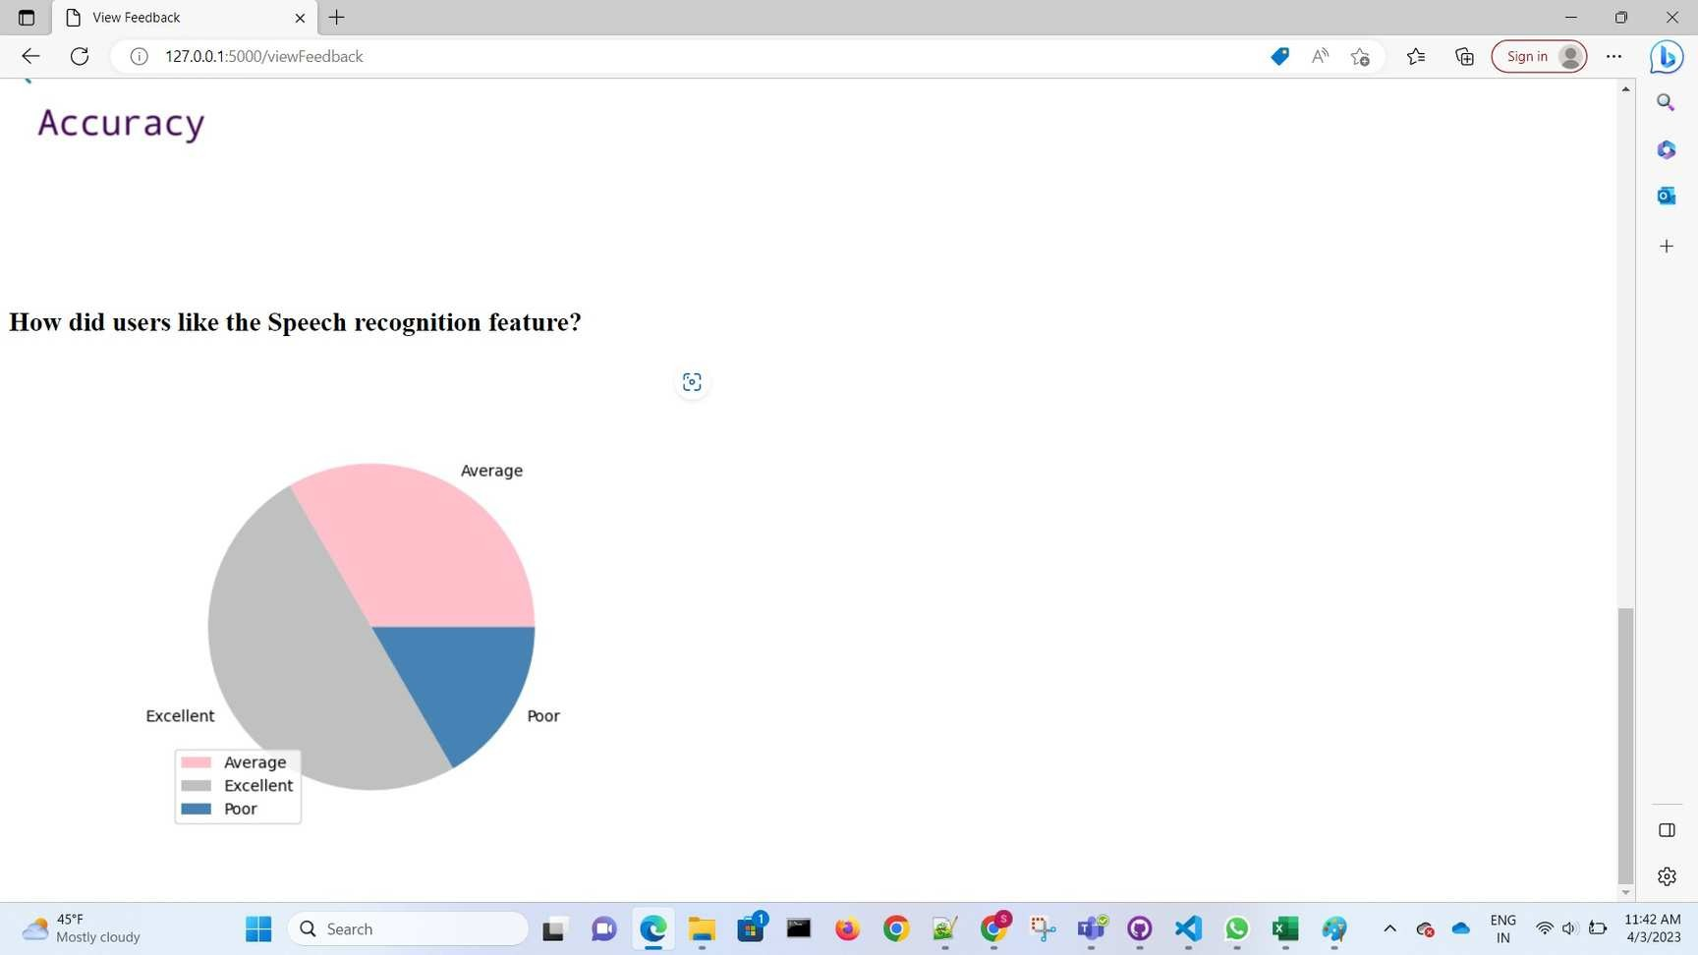

Slide 20










IMPLEMENTATION: TECHNOLOGIES USED
Speech Recognition Image Recognition using google cloud vision LSTM Algorithm
Python
Javascript, HTML, CSS SQLite
Flask Github GCP

Slide 21



TEAM MEMBERS
Sangeetha Nair
100884883
Viviana Lopes
100873273
Nandor Gallo
100662966
Purvi Patel
100851195

Slide 22


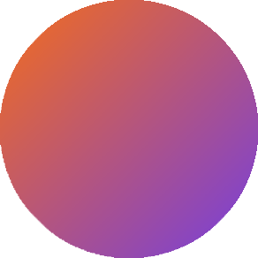


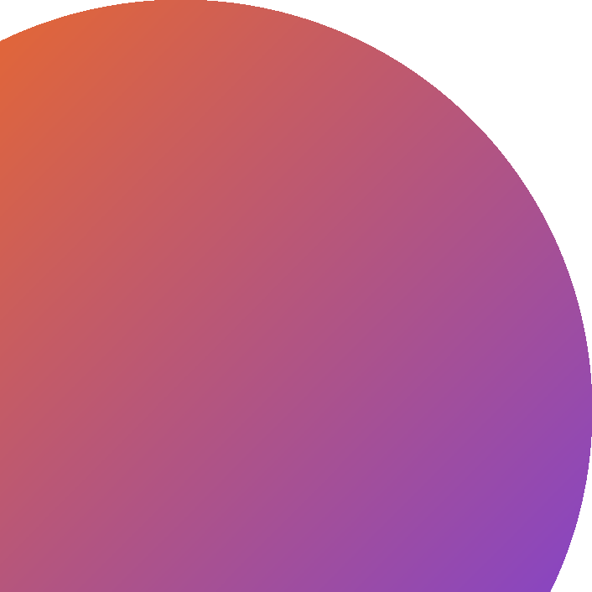
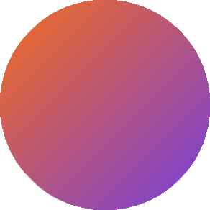
THANK YOU

